Slide 1
Mobile Apps Presentation
By Sam Locke

Slide 2
Introduction
This presentation will give a history on mobile apps.
It will also give a history of different operating systems.
It will also give an overview on the current operating systems that are currently widely used.
It will also give information about the future of mobile apps.

Slide 3
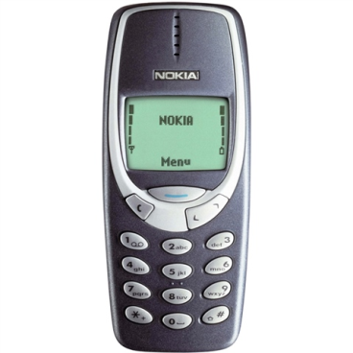
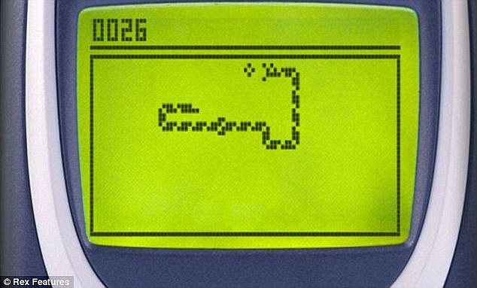
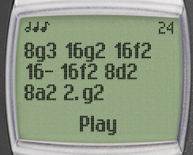
Mobile Apps History – The Early Years
Back in the early days of mobile phones, a lot of them had apps built in to their device.
These apps would include games, ringtone composers, calendar, phone and messages.
An example of an old mobile app would be Nokia’s famous Snake game.
The game itself featured in many versions of Nokia phones and a second version called Snake II was released on later models.

Slide 4
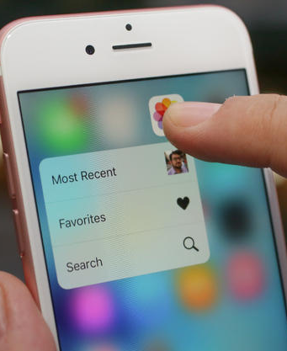
Mobile App History – The Present and Future
Startin. S (2015) states that apps may not be here in the future and will be replaced with services.
The development of mobile phones are costing less than they used to in early years.
In 2015, a lot of businesses are now told to work on their mobile strategies as many users out there now use smartphones and tablets more than using desktops and laptops.

Slide 5
Mobile Operating Systems
Most mobile phones these days run on a operating system.
Newer Nokia phones such as the Nokia 6300 ran on the Series 40 Interface.
As mobile technology grew, Nokia started to make Sybian phones. The Nokia N95 and the N73 were popular smartphones before the iPhone was released in 2007.
Other smartphones started to appear including Blackberry.
iOS from Apple came in 2007 (which was only called Apple iPhone OS back then), followed by Android in 2008 and then Windows Phone in 2010.
According to the IDC smartphone OS figures, Android is the highly popular OS rating at 82.8%, iOS rating at 13.9%, Windows Phone at 2.8%, Blackberry OS at 0.3% and other operating systems at 0.4%.

Slide 6
References
(2015) Starin M. A history of Mobile Apps. Available from: http://www.theguardian.com/media-network/2015/feb/13/history-mobile-apps-future-interactive-timeline [Accessed 27 November 2015].
(2015) Ding. A Brief History of Mobile Apps. Available from: https://www.ding.com/community/history-of-mobile-apps [Accessed 27 November 2015].
(2015) Empirical Works. The History Of App Development And What It Means For Companies In The Future. Available from: http://www.empiricalworks.com.au/blog/app-development/ [Accessed 25 November 2015].
(2015) Smartphone OS. Marketshare Available from: http://www.idc.com/prodserv/smartphone-os-market-share.jsp [Accessed 27 November 2015].

